Slide 1
Unite1: Computational Thinking and programming
1:1 Planing Flowcharacters
Learning Objectives
Key Concepts
By the end of the lesson, students will be able to:
Explain what an algorithm is.
Algorithm
Identify the steps in an algorithm.
Instructions
Understand that instructions need to be followed in the correct order.
Steps
Create a simple algorithm for a familiar task.
Sequence / Order

Slide 2
Key Vocabulary
Skills
Logical thinking
Algorithm — a set of instructions
Sequencing
Instruction — something that tells us what to do
Problem-solving
Step — one action in an algorithm
Following instructions
Sequence — the order of the steps

Slide 3
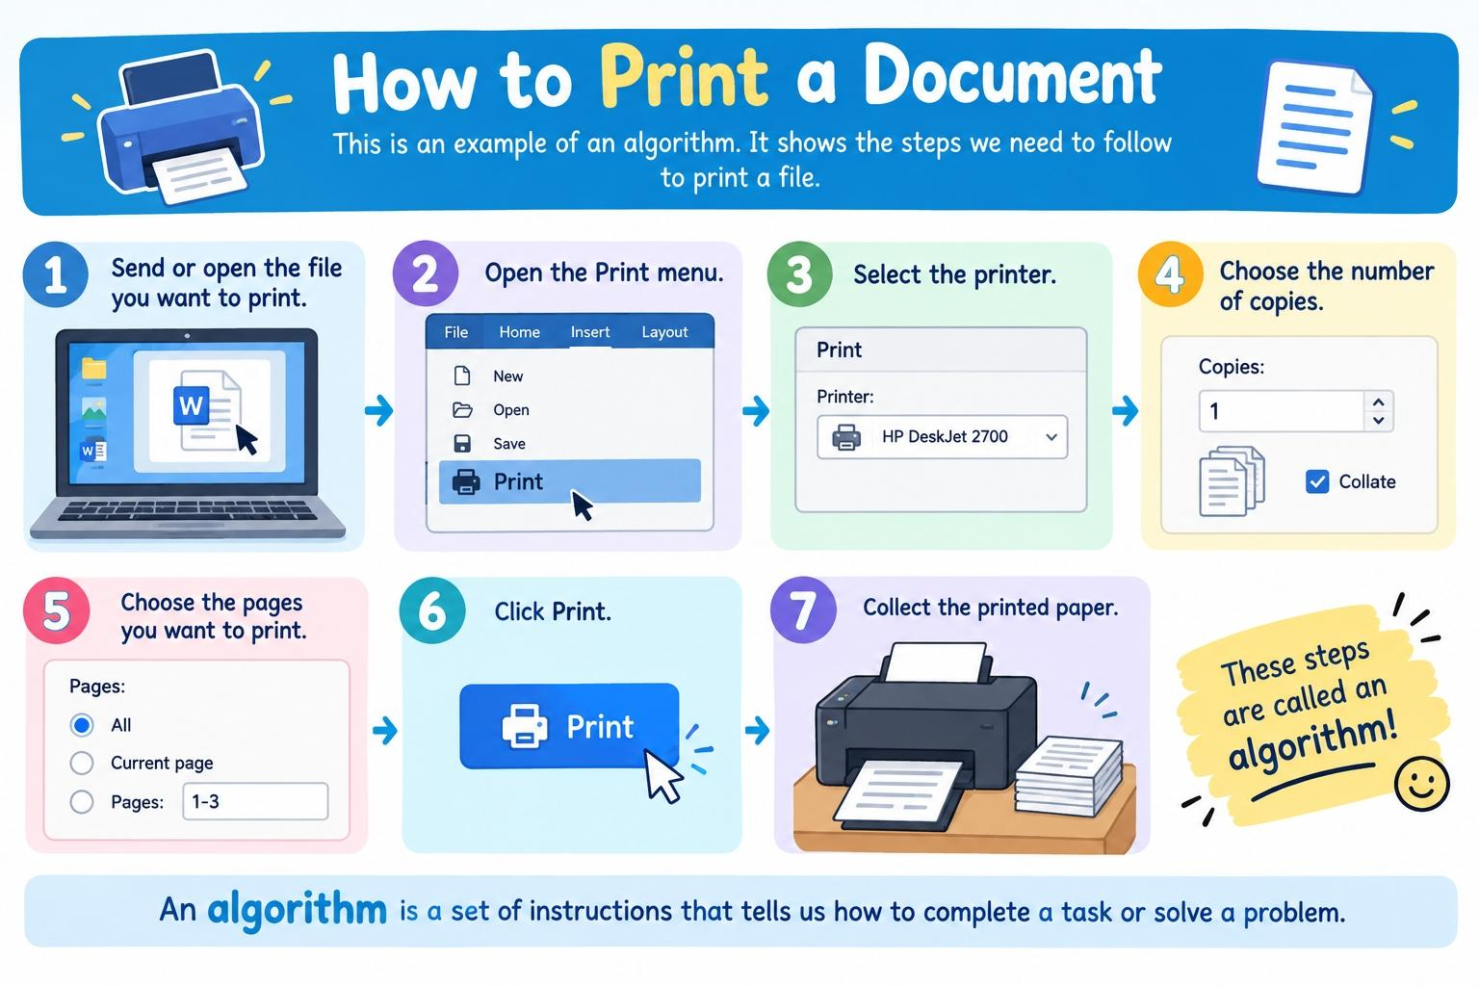
What is an Algorithm?
Algorithm = a set of instructions that tells us how to complete a task or solve a problem.
Example: Printing a Document
Algorithm = Steps to do something.
Algorithm: How to print a document
Send or open the file you want to print.
Open the Print menu.
Select the printer.
Choose the number of copies.
Choose the pages you want to print.
Click Print.
Collect the printed paper.

Slide 4


Sequence / Correct Order
Example: Printing a Document
Sequence = the order in which the instructions are followed.
Open the file.
Open the Print menu.
Errors / Bugs
Select the printer.
What happens if there is a mistake in the algorithm?
Choose the pages.
Click Print.
Bug
Collect the printed paper.
Correct Order
A bug is an error in an algorithm or a program.
Click Print.
Collect the printed paper.
Bug = a mistake or error.
Open the file.
Incorrect Order

